Slide 1
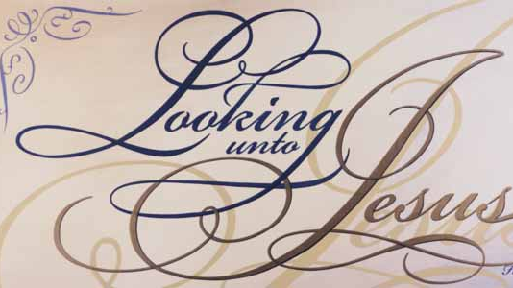
April Lesson Series

Slide 2
Chapter 12:1-2
Foundation Scripture

Slide 3
Therefore we also, since we are surrounded by so great a cloud of witnesses, let us lay aside every weight, and the sin which so easily ensnares us, and let us run with endurance the race that is set before us, looking unto Jesus, the author and finisher of our faith, who for the joy that was set before Him endured the cross, despising the shame, and has sat down at the right hand of the throne of God.

Slide 4
Chapter 15:57-58
Today’s Scripture Lesson

Slide 5
But thanks be to God, who gives us the victory through our Lord Jesus Christ. Therefore, my beloved brethren, be steadfast, immovable, always abounding in the work of the Lord, knowing that your labor is not in vain in the Lord.

Slide 6
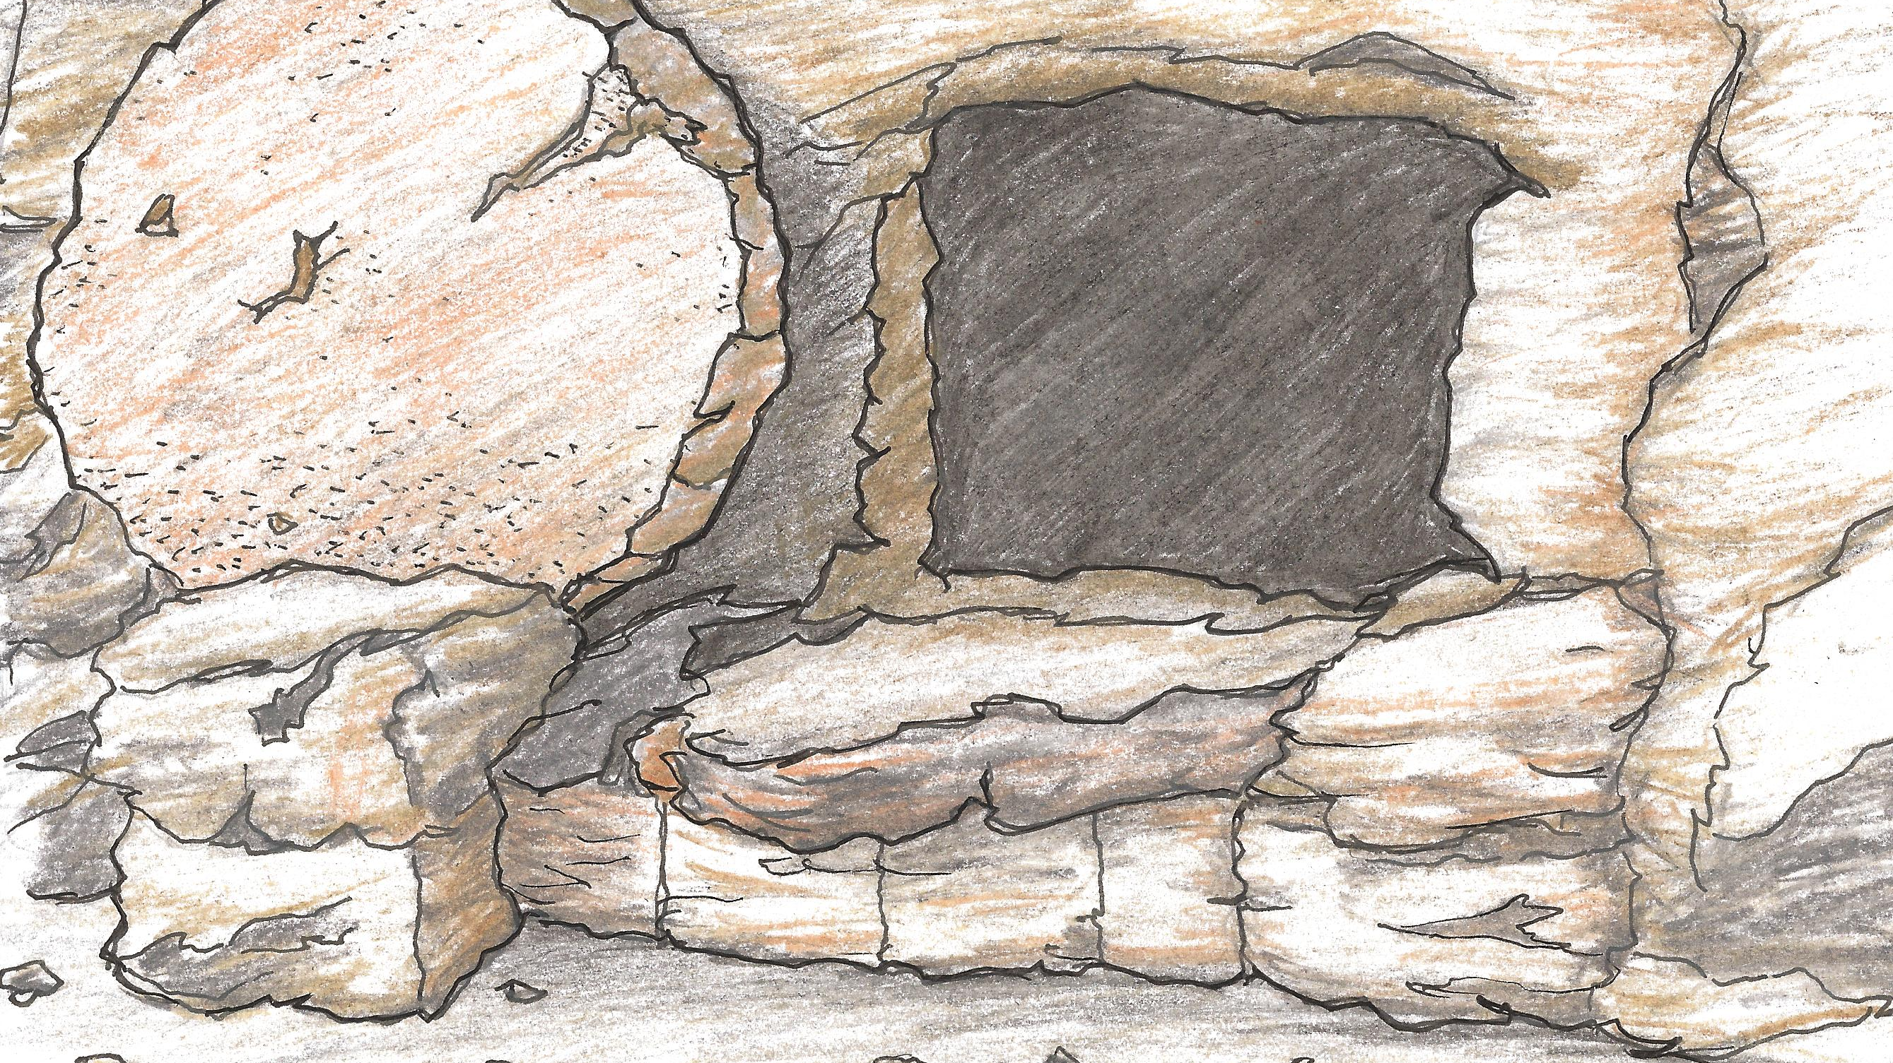
The Significance of the Resurrection
Lesson Title

Slide 7
Two Questions:
Do our lives demonstrate that we serve a risen Lord and Savior?
Do we possess the hope, peace, and strength that the reality and power of His resurrection gives to the Christian?

Slide 8
1. THE RESURRECTION WILL BRING STABILITY TO YOUR FAITH.

Slide 9
Therefore, my beloved brothers, be steadfast, immovable…
I Corinthians 15:58

Slide 10
"Be steadfast" means "be stable, be firm, fixed."

Slide 11
1. The gospel that is preached is in vain. (v.14)

Slide 12
2. Our faith is in vain. (v.14)

Slide 13
3. We will be false witnesses of God. (v.15)

Slide 14
4. Our faith is worthless. (v.17)

Slide 15
5. Those who have died have perished. (v.18)

Slide 16
“Be diligent to present yourself approved to God as a workman who does not need to be ashamed, accurately handling the word of truth.”
II Timothy 2:15

Slide 17
2. THE RESURRECTION WILL BRING JOY TO YOUR MINISTRY.

Slide 18
Therefore, my beloved brothers, be steadfast, immovable, always abounding in the work of the Lord…
I Corinthians 15:58

Slide 19
Do not be slothful in zeal, be fervent in spirit, serve the Lord. Rejoice in hope, be patient in tribulation, be constant in prayer. Contribute to the needs of the saints and seek to show hospitality.
Romans 12:11-13

Slide 20
Always abounding means "exceeding a fixed number or measure, over-and- above"

Slide 21
The righteous shall flourish like a palm tree, He shall grow like a cedar in Lebanon. Those who are planted in the house of the Lord Shall flourish in the courts of our God. They shall still bear fruit in old age; They shall be fresh and flourishing, to declare that the Lord is upright; He is my rock, and there is no unrighteousness in Him.
Psalm 92:12-15

Slide 22
Looking unto Jesus, the author and finisher of our faith, who for the joy that was set before Him endured the cross, despising the shame, and has sat down at the right hand of the throne of God. Your ministry, your relationship with the risen Christ should give you joy.
Hebrews 12:2

Slide 23
3. THE RESURRECTION WILL BRING FULFILLMENT TO YOUR LIFE.

Slide 24
Therefore, my beloved brothers, be steadfast, immovable, always abounding in the work of the Lord, knowing that in the Lord your labor is not in vain
1 Cor. 15:58

Slide 25
Unless the Lord builds the house, those who build it labor in vain. Unless the Lord watches over the city, the watchman stays awake in vain.
Psalm 127:1

Slide 26
And whatever you do, do it heartily, as to the Lord and not to men, knowing that from the Lord you will receive the reward of the inheritance; for you serve the Lord Christ.
Colossians 3:23-24

